Slide 1
Blockchain Based Crime Evidence System

Slide 2
Abstract
In conventional crime management systems, all data including crime reports and evidence are stored in centralized databases, making them vulnerable to tampering by administrators or hackers. Such vulnerabilities undermine the integrity of criminal investigations and legal proceedings. To address this critical issue, the proposed project implements a Blockchain Based Crime Evidence System that ensures tamper-proof, decentralized, and transparent storage of crime evidence using Ethereum blockchain technology.
The system leverages smart contracts written in Solidity to record and retrieve evidence data, which is then accessed via a Python-based web interface.

Slide 3
Introduction
Crime investigation and evidence management systems are critical components of law enforcement. However, traditional systems rely heavily on centralized databases, which are vulnerable to data tampering, unauthorized access, and lack transparency. Altering crime evidence records can lead to wrongful acquittals or convictions, undermining the justice system.
To address these vulnerabilities, this project proposes a Blockchain Based Crime Evidence System. By leveraging the decentralized and tamper-proof architecture of blockchain technology, this system ensures that crime evidence is stored securely and immutably across distributed nodes. Each evidence entry is treated as a block containing a unique hash, and any attempt to alter the data would disrupt the hash chain, thereby making tampering detectable and preventable.

Slide 4
Literature servvey
1. Limitations of Centralized Evidence Systems
Traditional crime evidence management relies on centralized databases that are vulnerable to tampering by administrators. There's no integrated mechanism to detect unauthorized changes, compromising the integrity of legal investigations.
2. Tamper-Proof Storage with Blockchain
Blockchain offers a decentralized and tamper-resistant architecture. Each data block is linked via unique hash codes, and any unauthorized modification results in hash mismatches, making tampering easily detectable and enhancing data integrity.

Slide 5
Existing System
Tampering Risk: The data stored on such a centralized database can be easily altered by individuals with administrative access. There are no built-in mechanisms to detect such unauthorized modifications.
Integrity Issues: Since crime evidence is crucial for legal proceedings and identifying culprits, any alteration can lead to wrongful acquittals or convictions.
Lack of Transparency: The system does not provide verifiable trails for when or how evidence was stored or accessed, making it difficult to ensure data authenticity.
No Detection Tools: There are no automated tools available in the current system to identify or flag unauthorized data alterations.

Slide 6
Drawbacks
• Centralized Storage
All crime and evidence records are stored in a single central server.
Single point of failure and easy to compromise.
• Tampering Possibility
Database administrators can alter or delete evidence without detection.
No built-in mechanism to detect unauthorized changes.

Slide 7
Proposed System
Decentralized Storage: Evidence data is not stored on a single server but across multiple nodes, reducing the risk of data loss or manipulation.
Immutability: Each data entry (block) is linked with a unique hash and timestamp. Any unauthorized change will alter the hash, making tampering detectable.
Audit Trail: All operations—such as adding or retrieving evidence—are recorded in blocks with full transparency and traceability.
Smart Contracts: Evidence can be securely recorded and accessed via smart contracts written in Solidity. These contracts define specific functions to manage evidence, and interactions with them are logged permanently on the blockchain.

Slide 8
Advantages
🔐 Tamper-Proof & Immutable
Once evidence is added to the blockchain, it cannot be changed or deleted.
Any tampering attempt is immediately detected through hash mismatches.
🧩 Decentralized Storage
Data is stored across multiple nodes, eliminating a single point of failure.
More secure and resilient to attacks.

Slide 9
HARDWARE REQUIREMENTS:
• System : Pentium IV 2.4 GHz.
• Hard Disk : 40 GB.
• Ram : 512 Mb.

Slide 10
SOFTWARE REQUIREMENTS:
• Operating system : Windows.
• Coding Language : python.

Slide 11
Modules
Admin Login
Add Officer Details
View Officer
View Evidence
Officer Login
Add New Evidences
Access Evidences

Slide 12
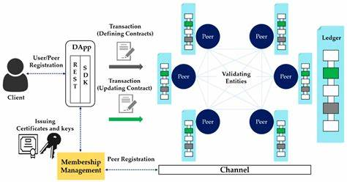
System Architecture:

Slide 13
UML
Class Diagram:

Slide 14
Use case Diagram:

Slide 15
Sequence Diagram:

Slide 16
Collaboration Diagram:

Slide 17
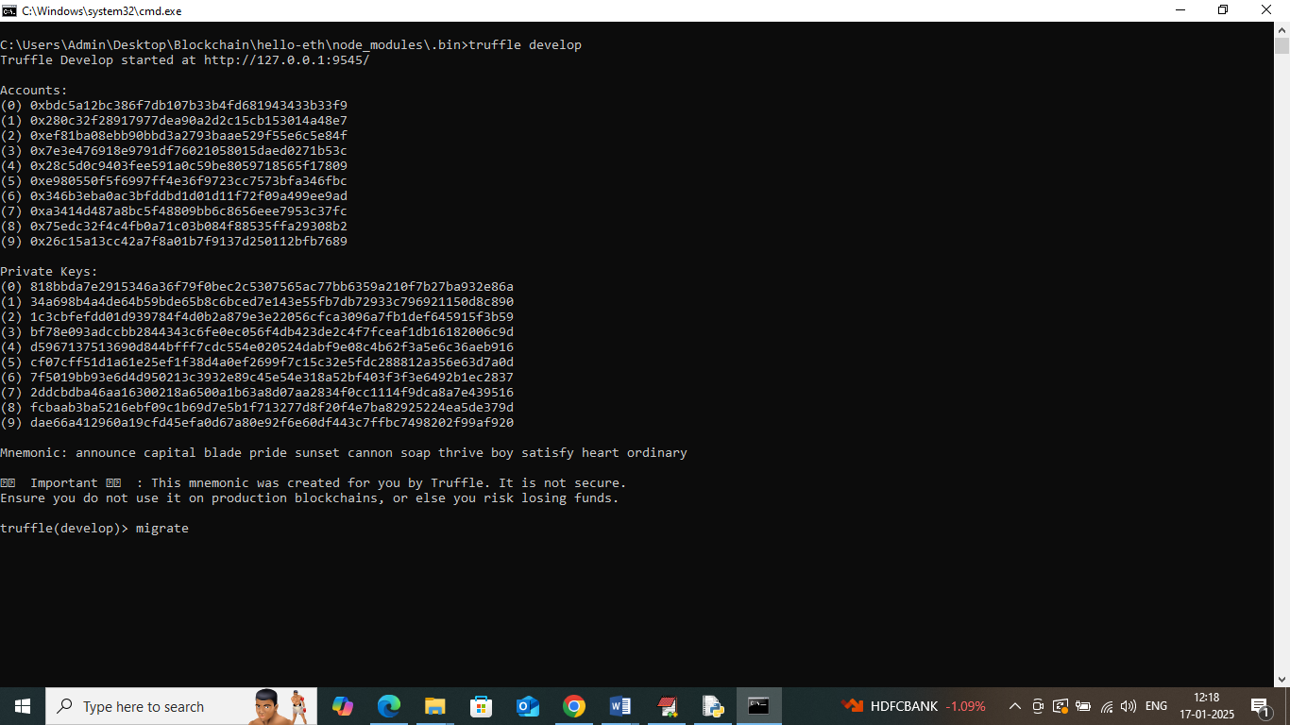

Slide 18
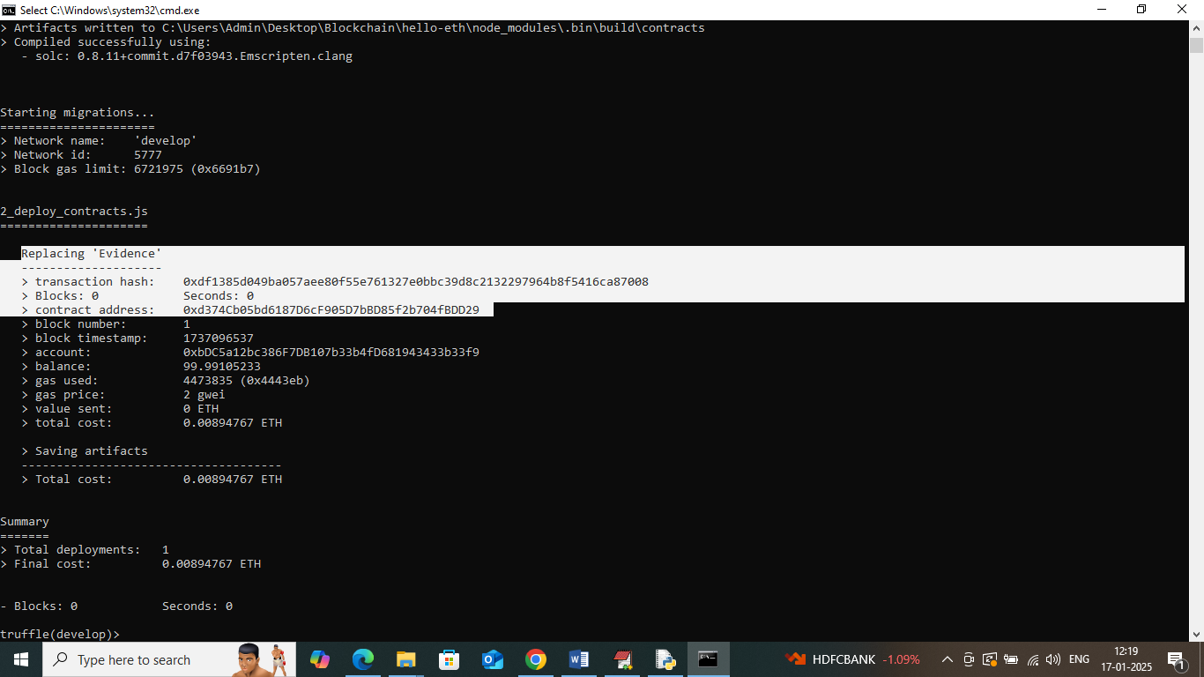

Slide 19
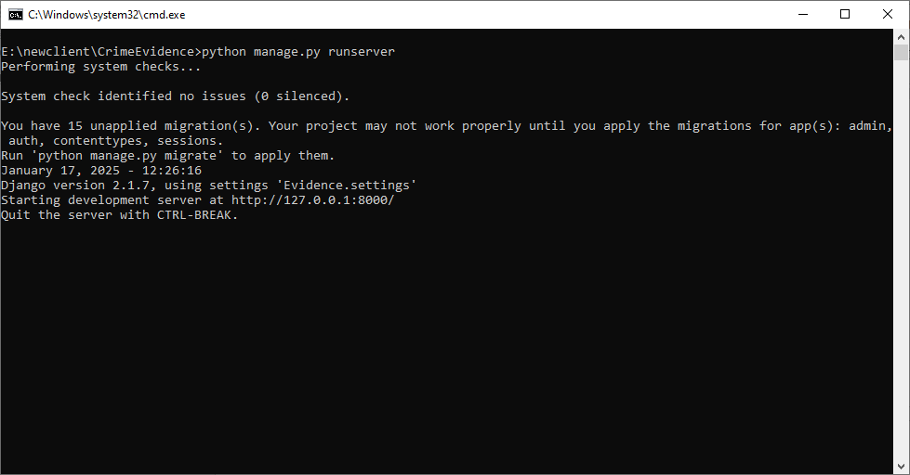

Slide 20
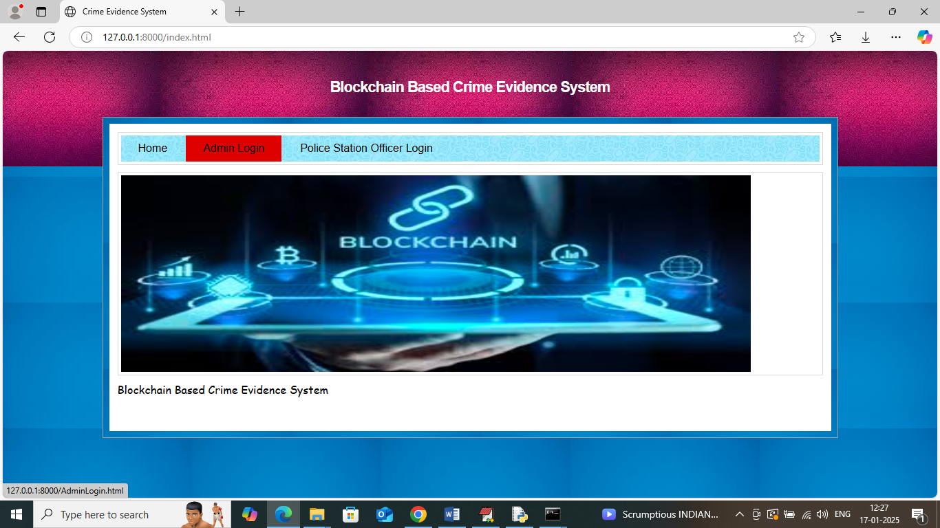

Slide 21
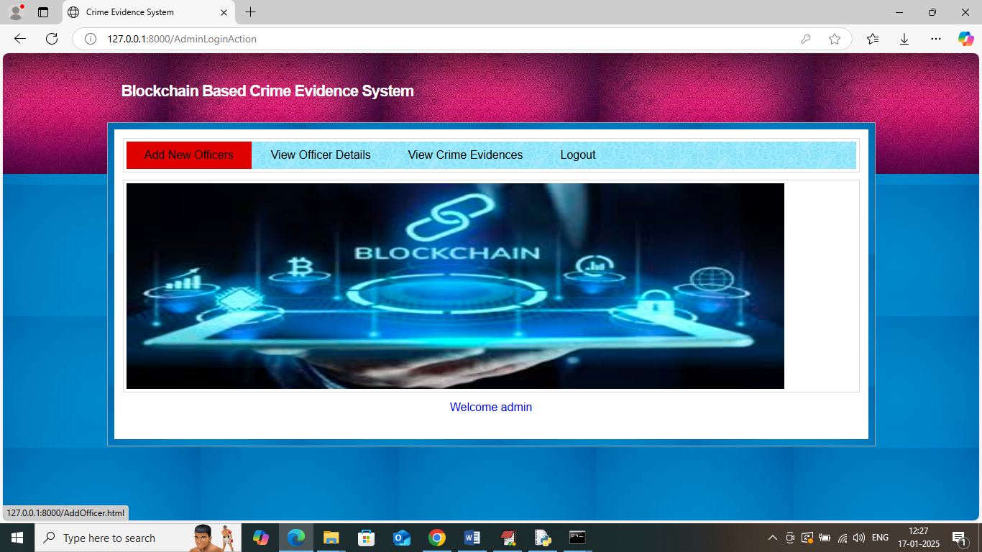

Slide 22
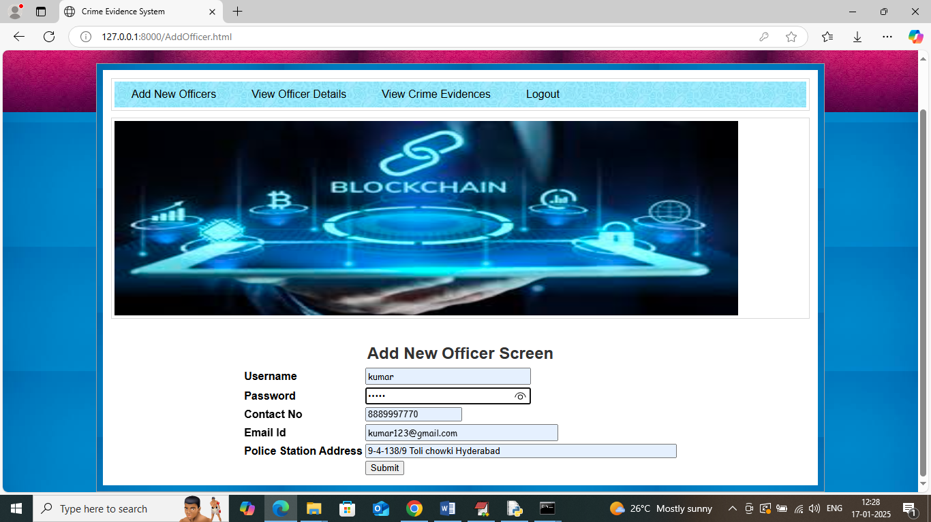

Slide 23
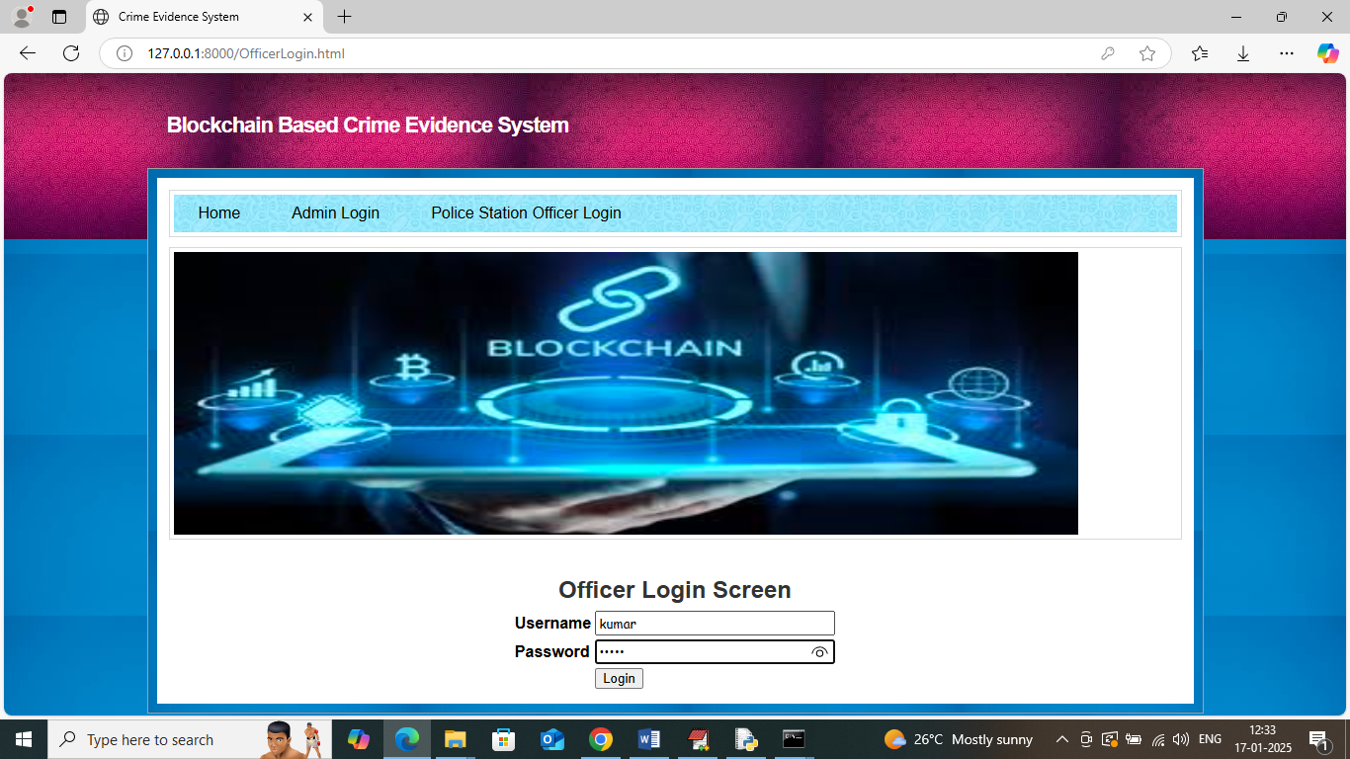

Slide 24
Conclusion
The "Blockchain Based Crime Evidence System" successfully demonstrates how blockchain technology can be leveraged to secure, decentralize, and authenticate crime evidence records. Traditional centralized crime evidence systems are vulnerable to tampering, primarily due to unrestricted access by administrators and the lack of traceable audit trails. By using blockchain's immutable and transparent ledger, this system ensures that once evidence is recorded, it cannot be altered or deleted without detection.
Through smart contracts deployed on Ethereum and integrated with a user-friendly Python-based frontend, both administrators and officers can safely add, retrieve, and view evidence-related data.

Slide 25
Future work
Integration with National Crime Databases: Future iterations could interface with centralized national or interdepartmental crime databases to allow broader access and verification.
Mobile Accessibility: Implementing mobile apps for Android and iOS can help officers log evidence from the crime scene in real time, improving efficiency and timeliness.

Slide 26
Reference
Nakamoto, S. (2008) Bitcoin: A Peer-to-Peer Electronic Cash System This is the original whitepaper that introduced blockchain technology and its decentralized, tamper-proof architecture. Link
Zheng, Z., Xie, S., Dai, H., Chen, X., & Wang, H. (2018) An Overview of Blockchain Technology: Architecture, Consensus, and Future Trends In 2017 IEEE International Congress on Big Data (BigData Congress) DOI: 10.1109/BigDataCongress.2017.85 This paper provides a comprehensive overview of blockchain technology and its application in secure data storage.

Slide 27
THANK YOU

